Slide 1

PRESENTATION FOR AIRCRAFTS RISK by
STEPHEN PALIA JILANI

Slide 2

BUSINESS AND DATA UNDERSTANDING
This project is for an aviation company that is in the process of expanding into new industries; and is in the process of purchasing a new aircraft. What the new aviation division of the company does not understand is the potential risk associated with each plane they may aim to buy. The purpose of this project is to ascertain the aircraft that provides the company with the minimum possible risk, and to result in actionable insights that will help the aviation division decide which aircraft to purchase.
The data is from a CSV file that was published by the National Transport and Safety Board with details of aircraft accidents from 2018 to 2022.

Slide 3
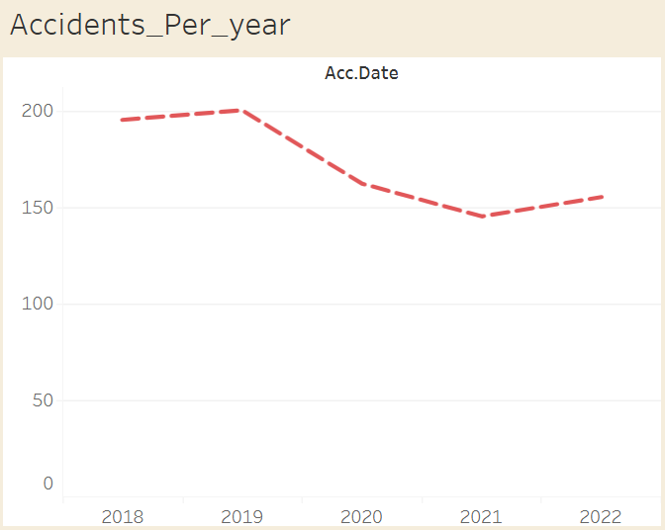
NUMBER OF ACCIDENTS PER YEAR
The graph is representative of the number of accidents that have occurred over the years in the dataset. This indicates that accidents were at their lowest in 2021 making it the best year for management to consider while making the decision on the safest aircrafts.

Slide 4

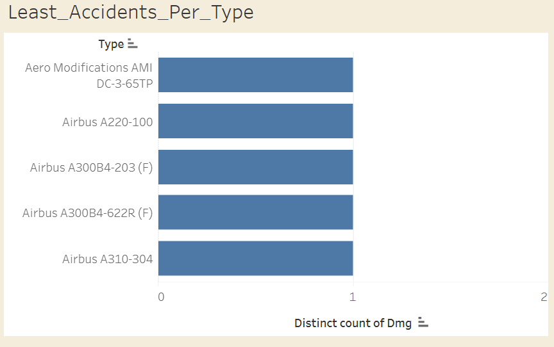
LEAST ACCIDENTS PER AIRCRAFT TYPE
Above is a graph of aircraft types with the minimum number of accidents in the period covered by the data. This has been limited to the bottom 5 in the dataset. This plus other factors will need to be put into consideration when making a decision as all 5 aircrafts have the same number of accidents in the period covered.

Slide 5
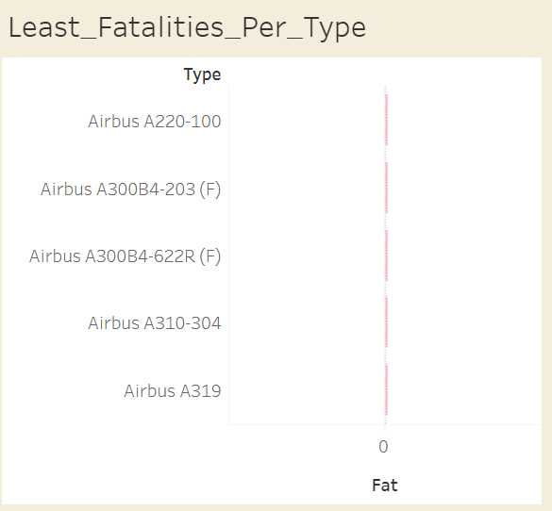
AIRCRAFT TYPES WITH LEAST FATALITIES
Above is a graph of aircraft types with the minimum number of fatalities in the period covered. This forms another basis for decision making but comes second to the aircrafts that have least accidents. This is because for an aircraft to have the least fatalities, it has to have an accident first and that is inferior to an aircraft that rarely has accidents in the first place.

Slide 6
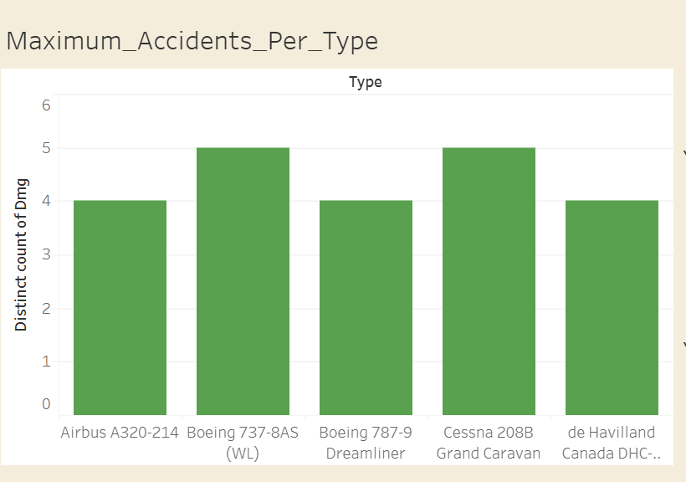
AIRCRAFT TYPES WITH MOST ACCIDENTS
Above is a graph of aircraft types with the maximum accidents in the period covered. This was an extra dashboard that was prepared to give stakeholders a spread of the difference between the aircrafts that have had the least accidents and the ones that have had the most accidents.

Slide 7
INSIGHTS AND RECOMMENDATIONS
Yearly Accidents: 2021 had the fewest accidents making it the best year for management to make a decision regarding the best candidate for the aircraft. The recommendation is to use this year as reference as it indicates that flights were the safest.
Aircraft with Least Accidents: Bottom 5 aircraft types that had the fewest accidents form the ideal candidates for management’s selection. Factoring other factors like cost, and maintenance expenses, these aircrafts can be the best candidates for purchase.
Aircraft with Least Fatalities: Bottom 5 aircraft types that caused the fewest fatalities, showing strong safety performance in challenging situations come second in being good candidates. This is an alternative approach to choosing the best candidate. However, similar factors as mentioned above need to be put into consideration.
Aircraft with Most Accidents: Maximum accident aircraft highlight risk spread, emphasizing management’s role in choosing low-risk aircraft.

